Slide 1
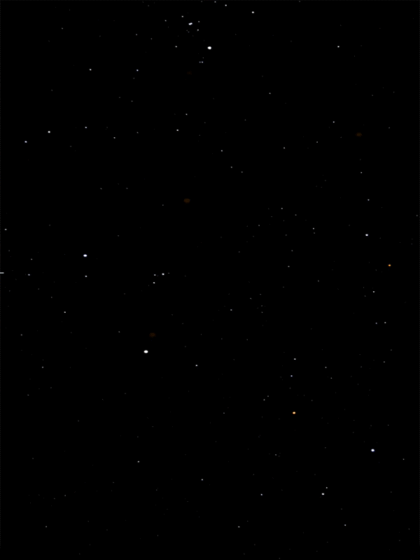



Slide 2
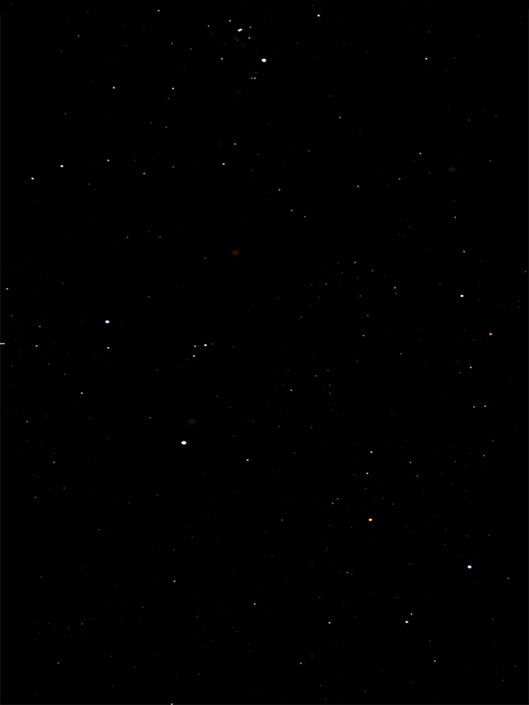
Welcome to CV Shooter.
This is a space shooter game controlled by opencv color detection. You need a red object to play this game.
On your right, there should be a webcam view with lines dividing the entire screen.
The ship can move 8 different directions based on where the red color is detected.
Try moving the ship!
Press Q to quit to main menu

